Slide 1
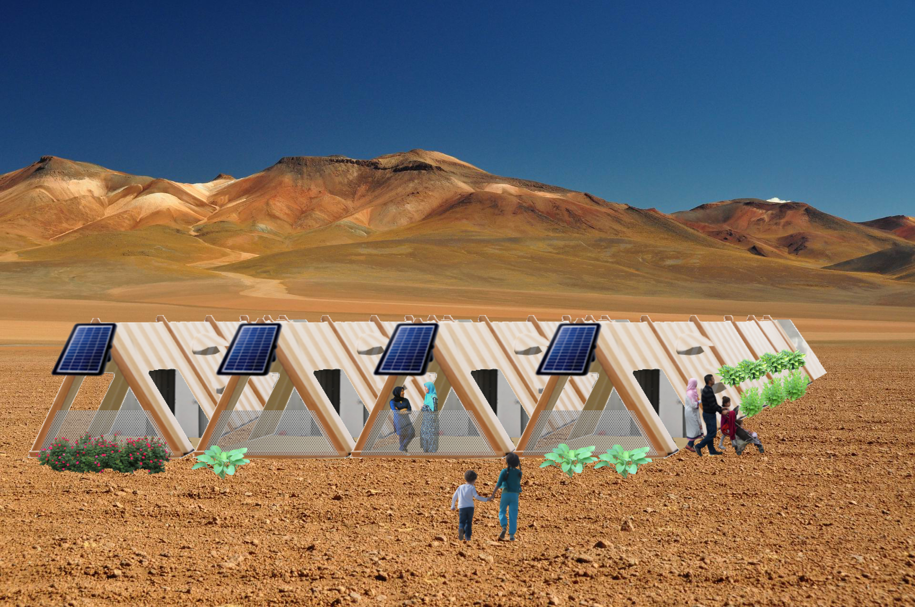
Refugee Shelter: Rapid-Deployment Truss Shelter Community
Scottie Manners

Slide 2
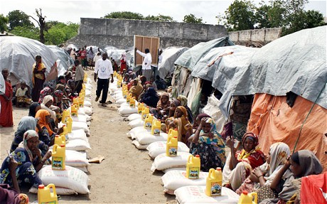
The Problem
Millions of refugees displaced from homes and countries every year
Refugee camps are crowded/running out of room
Strained food supply
UNHCR support is spread thin
Current shelters cannot withstand certain conditions like winters or are unbearable in the desert.

Slide 3
The Location: Urfa Turkey
Over 1 Million Syrians fled to Turkey and Turkish Government is running out of resources for the refugees including land and food
Turkey has snowy winters and hot summers
Most camps are located within cities and are crowded

Slide 4
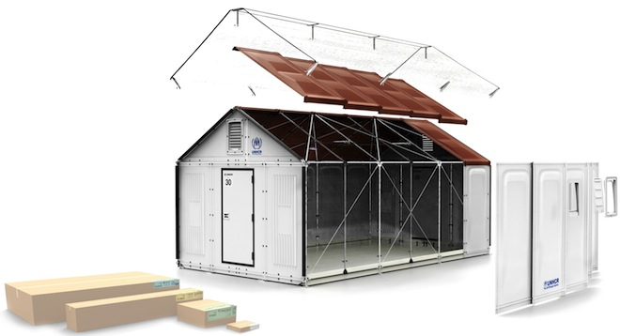
What refugee shelters are out there?
IKEA Flat Pack Shelter
Canvas Hoop House
Sold for $1000
No-tool assembly
300lb package
No floor
3 yr lifespan of plastic shell
4 hr setup
Ventilation and windows
Readily Available
Assembly requires many people helping
No floor
Cold in winter
No insulation or ventilation
Torn easily
Short tarp lifespan

Slide 5
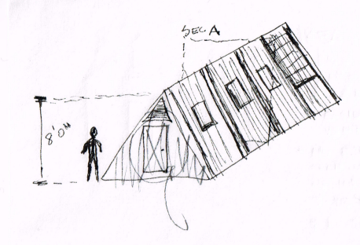
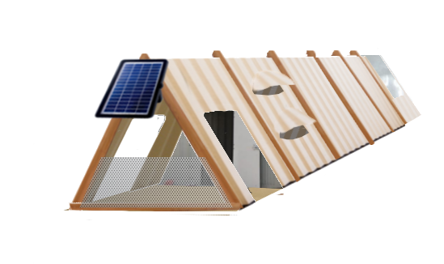
The Solution: Rapid-Deployment Truss Shelter
Easy to walk out accordion sections
No Tool-assembly
Modular, stackable, and light
PVC Floor layer and insulation
Greenhouse space
Customizable inside and out
Plumbing and electricity
$1400 for much more in value

Slide 6
Pricing Estimate
Plain 3-4 Compartment
$500-700
Deluxe 5-6 Compartment
$1000-1400

Slide 7
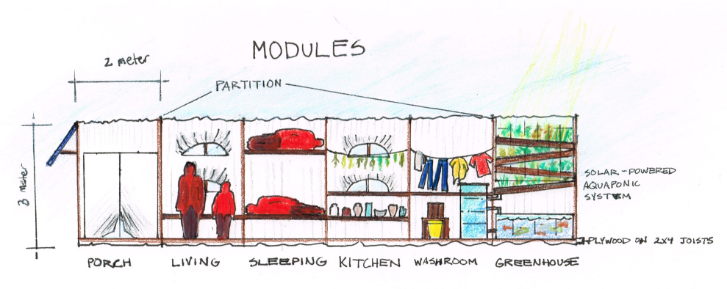
How it Works
2 People walk out the shelter in seconds
Each “room” is a separate section to walk out, and connect in place to each modular “room”

Slide 8
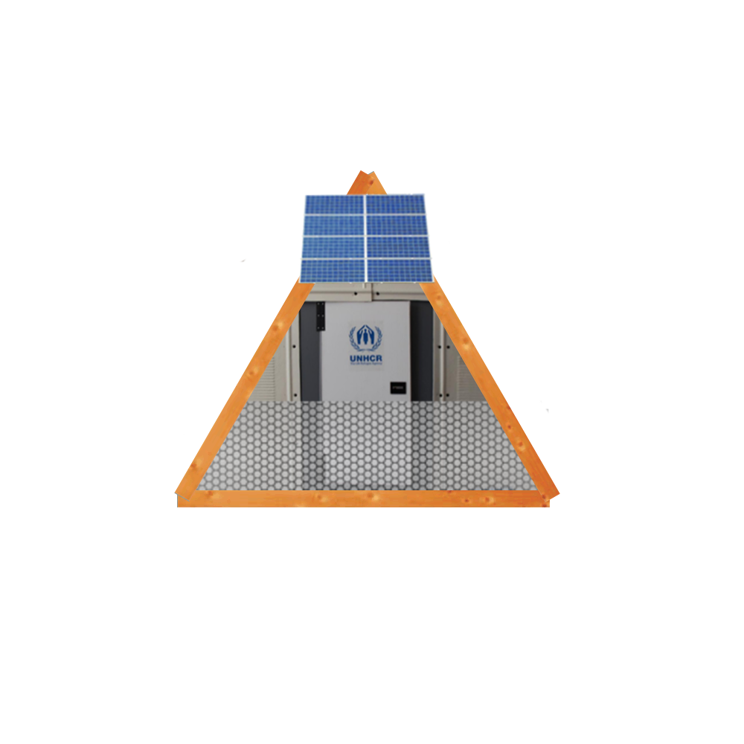
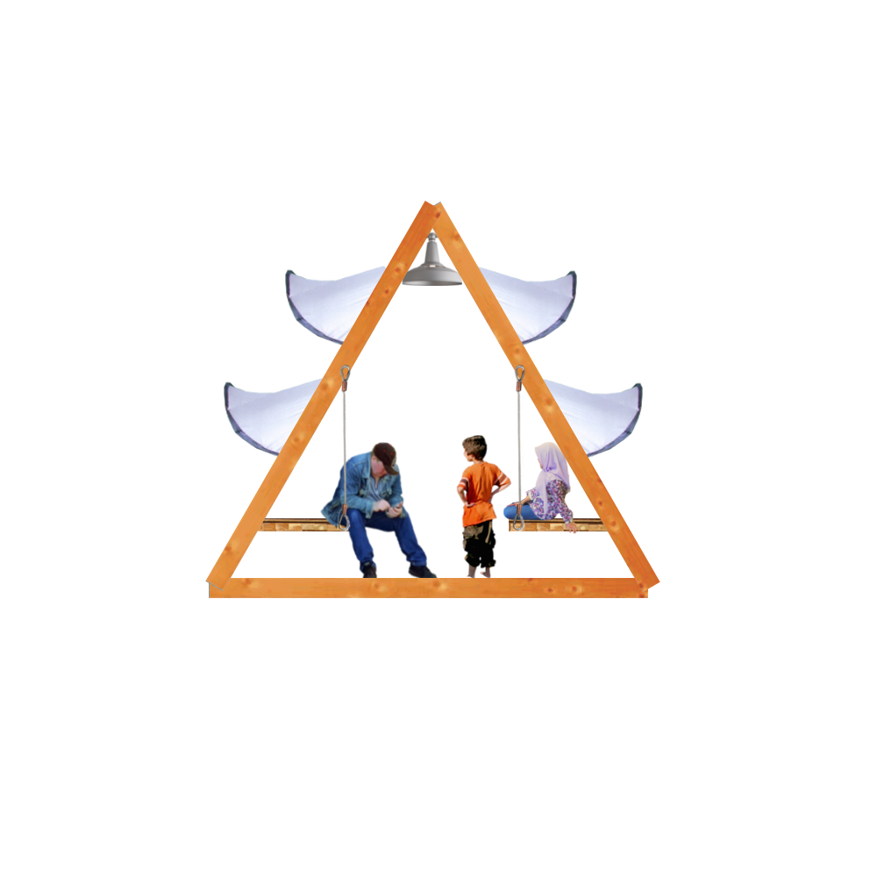
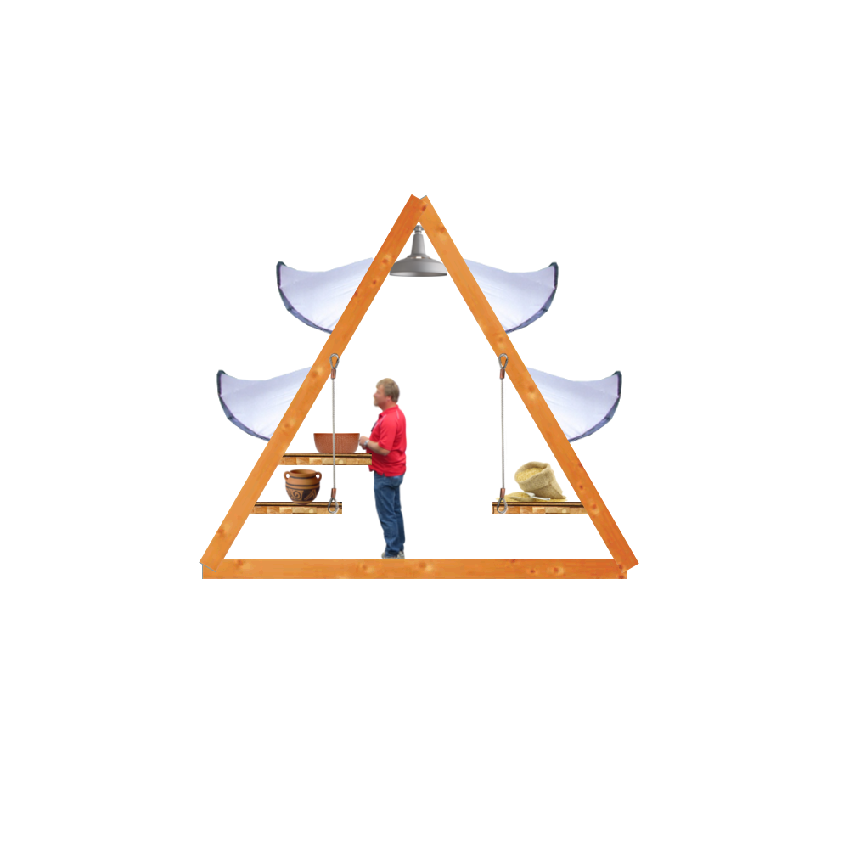
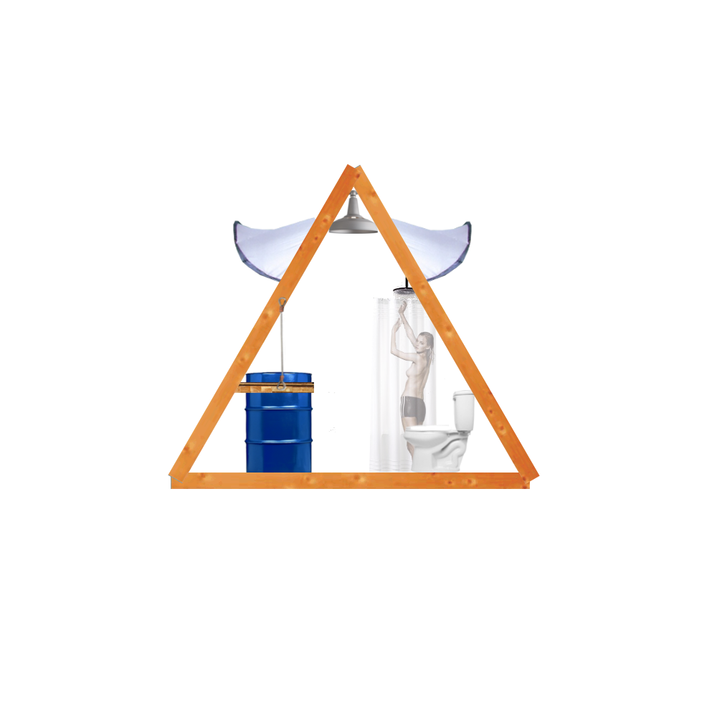
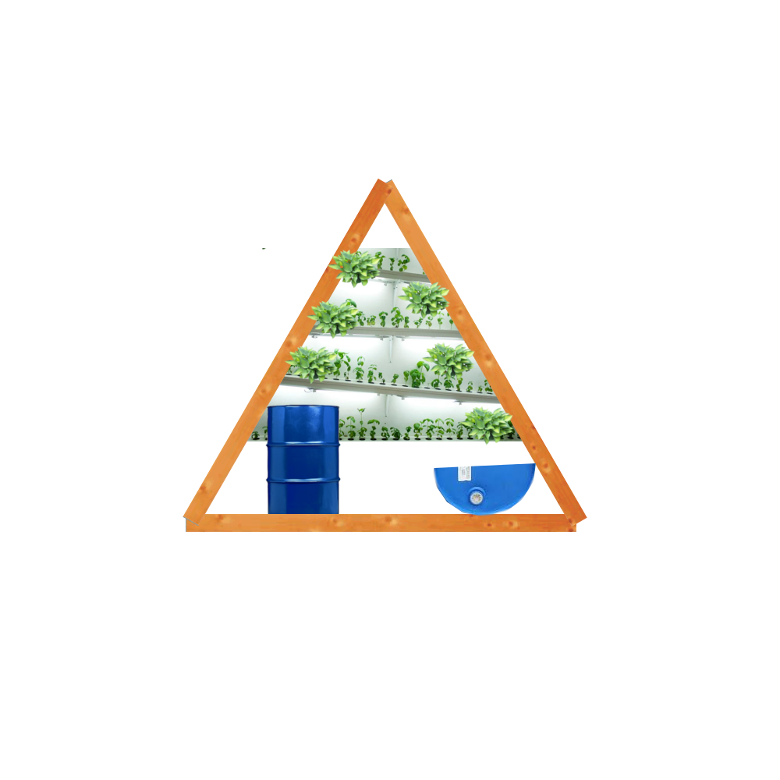
Different Modules for Different Needs
Porch
$206
Living
$178
Sleeping
$178
Cooking
$178
Bathing
$234
Food Production
$424

Slide 9
Stackable Truss Community
Stackable up to 3 shelters high
Porch provides a walkthrough to unit
Empty voids between shelters adds additional space for living/utility
The triangle creates a strong truss shape for a durable stack

